Slide 1
Identifying Exoplanets with Machine Learning Methods: A Preliminary Study
2021/12/14
Yucheng Jin, Lanyi Yang, Chia-En Chiang
University of California, Berkeley

Slide 2
Outline
Introduction
Related Work
Methodology
Experimental Results & Analysis
Future Work

Slide 3
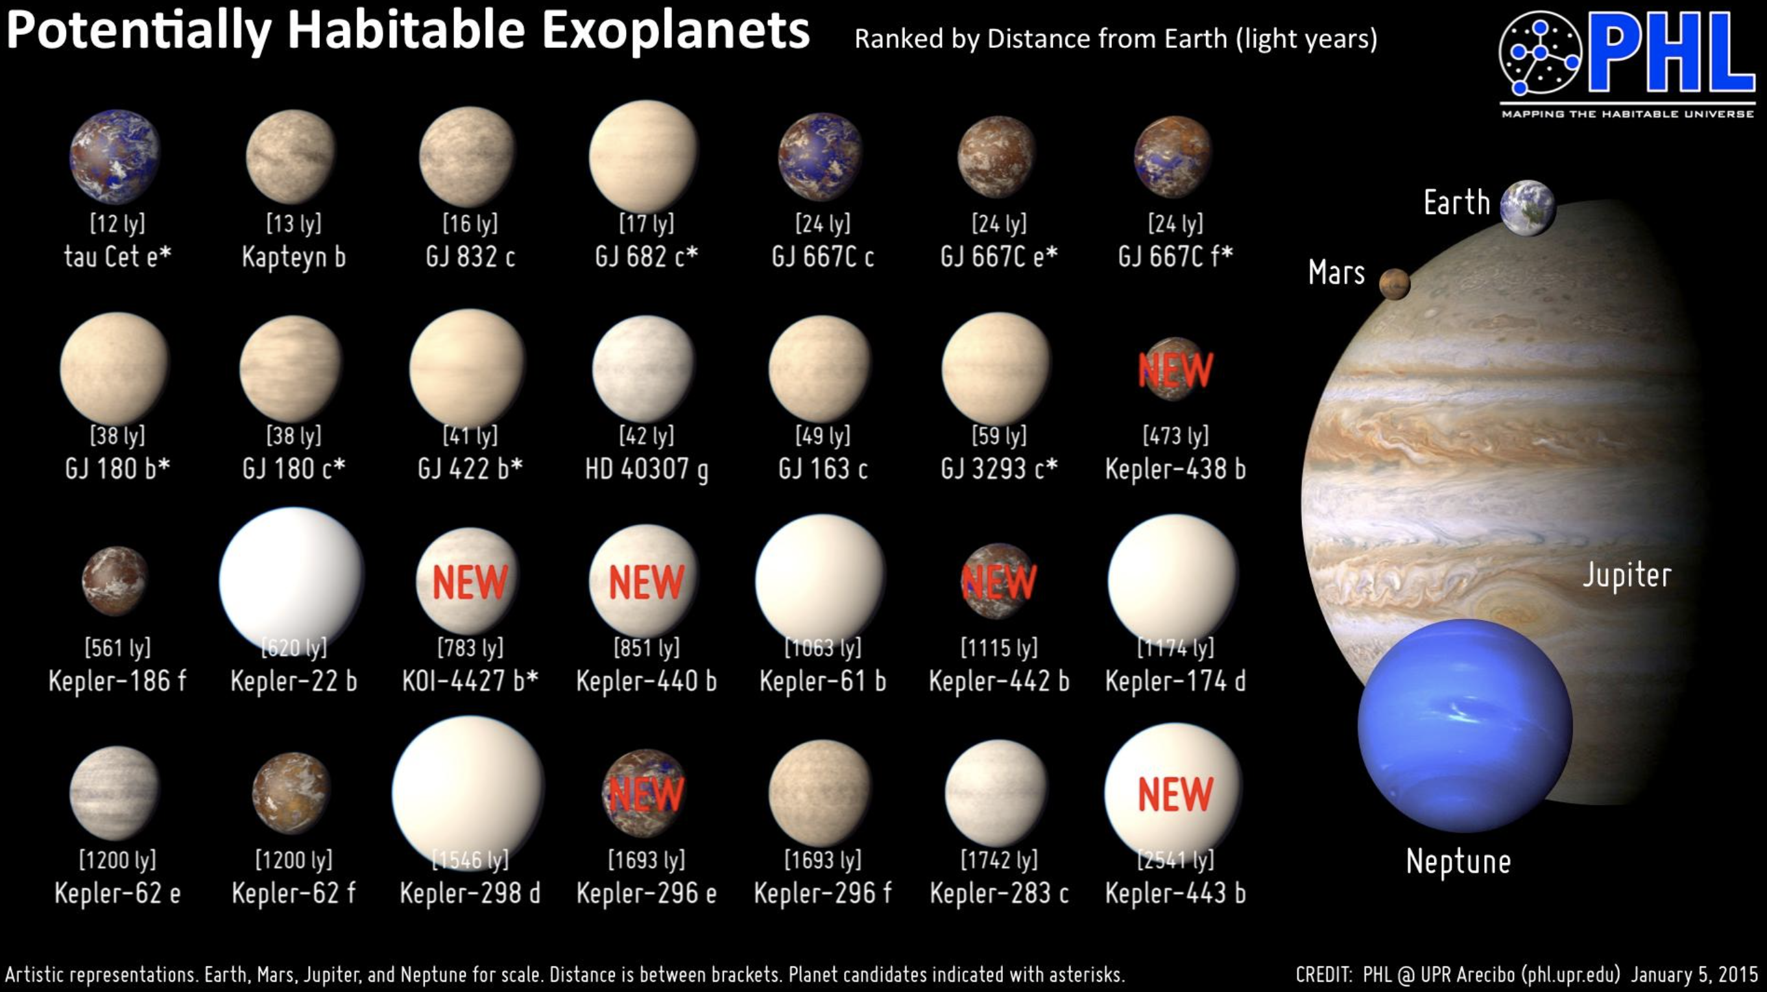
Introduction
The discovery of habitable exoplanets is a heated topic in astronomy
Identification of a potential exoplanet is a complicated problem

Slide 4
Introduction
Traditional methods, such as the wobble method, direct imaging, and gravitational microlensing are expensive, time-consuming, and sensitive to variation in the measurement [1]
In this study, we proposed the idea of using machine learning methods for exoplanet identification
We investigated both supervised learning and unsupervised learning. The supervised learning objective is three-categorical classification. The unsupervised learning objective is clustering
[1] Breitman, Daniela (2017). “How do astronomers find exoplanets?”. EarthSky.org. Online. Retrieved from https://earthsky.org/space/how-do-astronomers-discover-exoplanets/.

Slide 5
Outline
Introduction
Related Work
Methodology
Experimental Results & Analysis
Future Work

Slide 6
Related Work
Contribution of NASA’s Kepler Mission
NASA’s Kepler Mission and its impact on exoplanet identification [2]
Advances in exoplanet science from the Kepler Mission [3]
ML-based algorithms in exoplanet discovery
Exoplanet discovery with deep learning [4]
Classification models comparison based on the Kepler data [5]
[2] Batalha, Natalie M. (2014). “Exoplanet populations with NASA’s Kepler Mission”. Proceedings of the National Academy of Sciences. 111 (35) 12647-12654, September 2014. DOI: 10.1073/- pnas.1304196111.
[3] Lissauer, Jack J., Dawson, R. I., and Tremaine, S. (2014). “Advances in exoplanet science from Kepler”. Nature. 513, 336–344, 2014. DOI: 10.1038/nature13781.Shalluel, Christopher J. and Vanderburg Andrew (2018). “Identifying
[4] Exoplanets with Deep Learning: A Five-planet Resonant Chain around Kepler-80 and an Eighth Planet around Kepler- 90”. The Astronomical Journal. Volume 155, Number 2, 30 January 2018. DOI: 10.3847/1538- 3881/aa9e09.
[5] Saha, Rohan (2019). “Comparing Classification Models on Kepler Data”. arXiv:2101.01904v2. DOI: 10.13140/RG.2.2.11232.43523.

Slide 7
Outline
Introduction
Related Work
Methodology
Experimental Results & Analysis
Future Work

Slide 8
Methodology Dataset Description
Kepler dataset - for supervised learning
Collected by NASA Kepler Mission
A total number of 9,564 potential exoplanets
Features contain characteristics of the exoplanet candidates
Target Variables: the existence status of the exoplanet candidate
“CONFIRMED” (labelled as 1)
“CANDIDATE” (labelled as 0)
“FALSE POSITIVE” (labelled as -1)
Confirmed exoplanets dataset - for unsupervised learning
Contains stellar and planetary parameters of 4,375 confirmed exoplanets
Crucial parameters: radius, mass, density, temperature

Slide 9
Methodology Data Cleaning & EDA
Data cleaning
Drop feature columns with large proportion of empty entries
Fill empty entries with proper values
EDA
Correlation analysis
Univariate analysis
Bivariate analysis

Slide 10
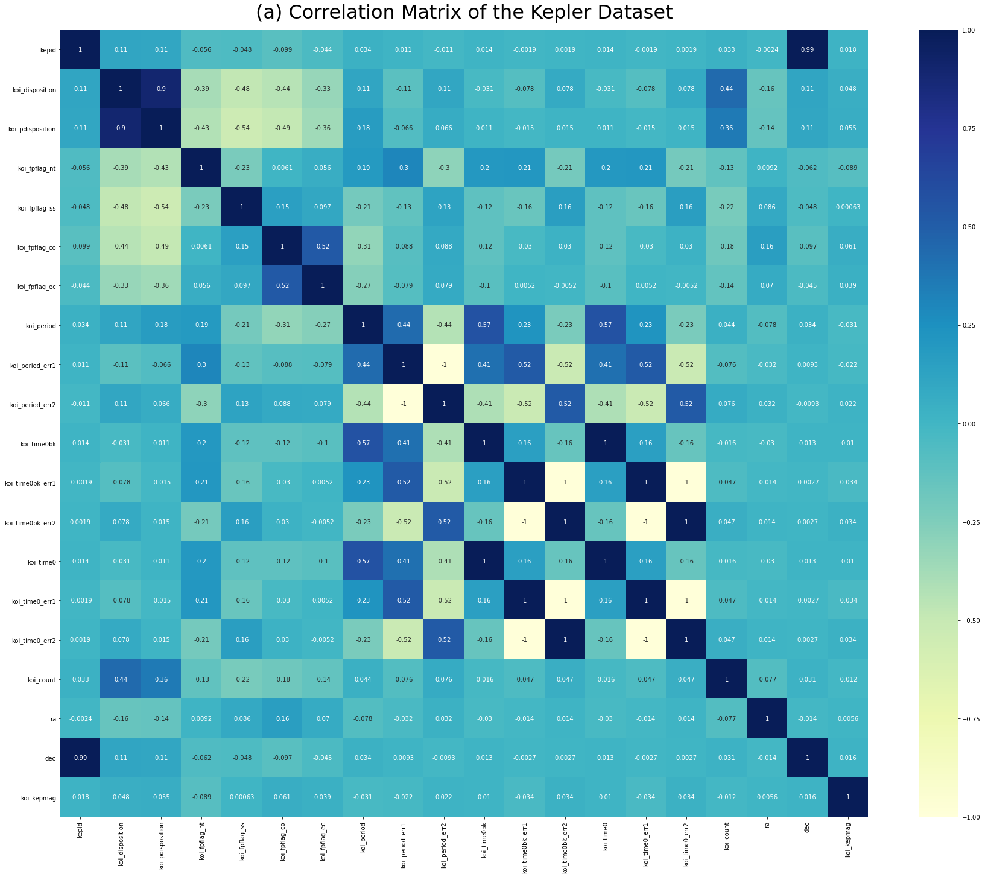
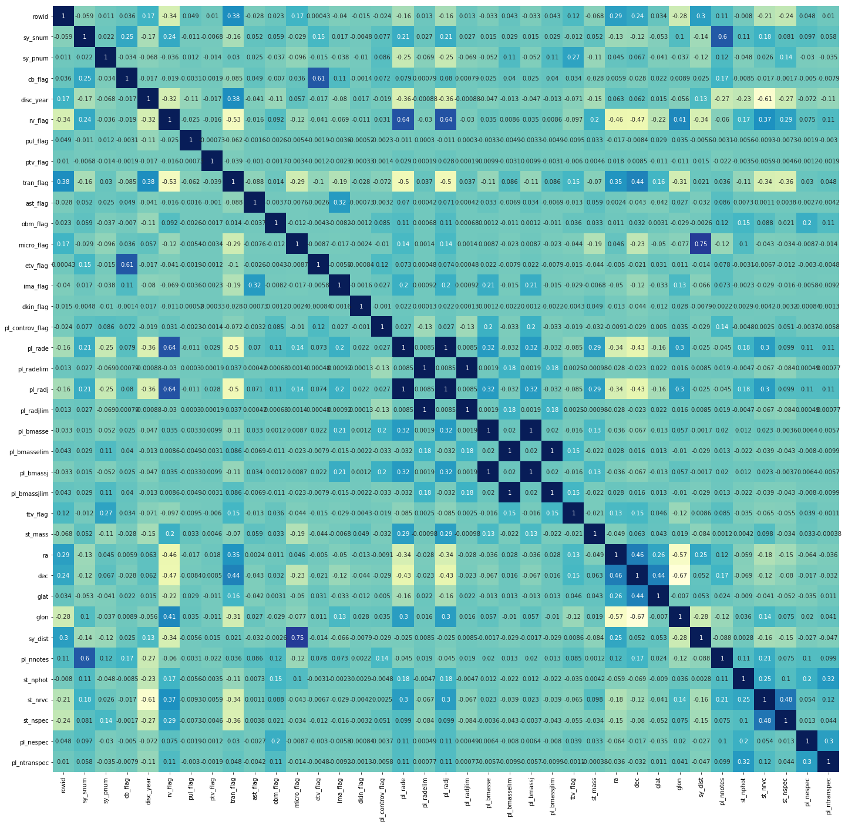
Methodology EDA: Correlation Analysis
Fig 1. Correlation Matrices of the Kepler Dataset and Confirmed Exoplanets Dataset

Slide 11
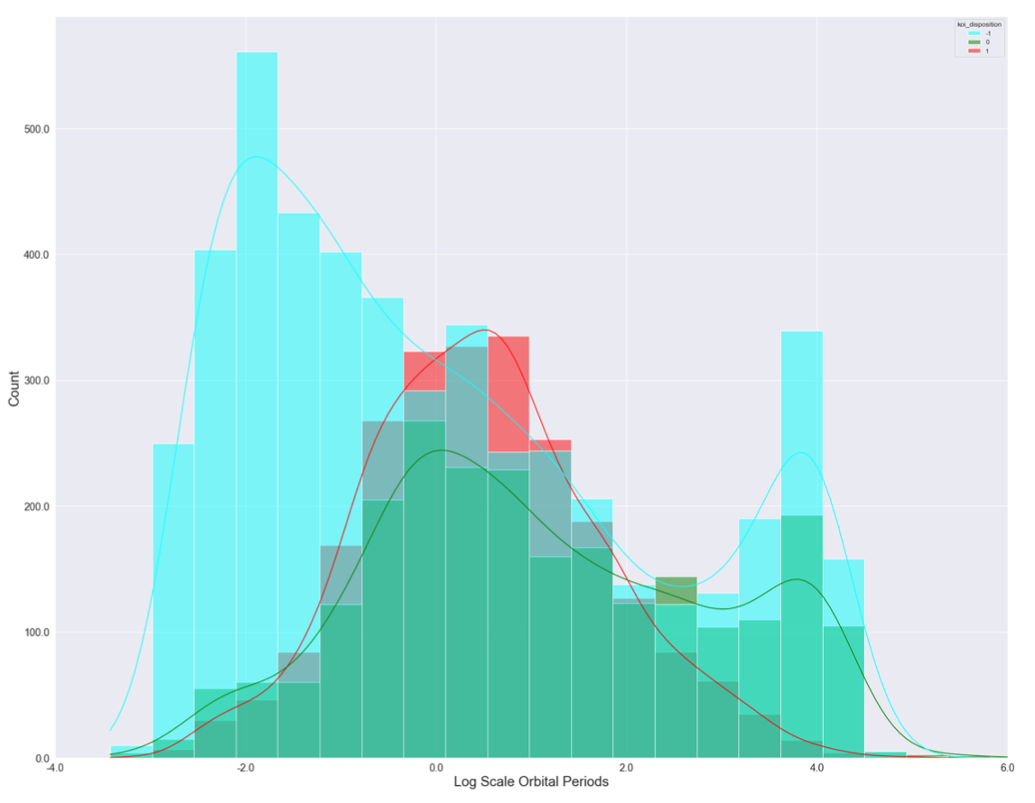
Methodology EDA: Univariate Analysis
Fig. 2 shows the relationship between the log scale orbital period and target variable
The confirmed exoplanets follow a Gaussian distribution with respect to the log scale orbital period in the range between -2 and 4
Fig 2. Histogram of the Log Scale Orbital Periods of the Kepler Dataset

Slide 12
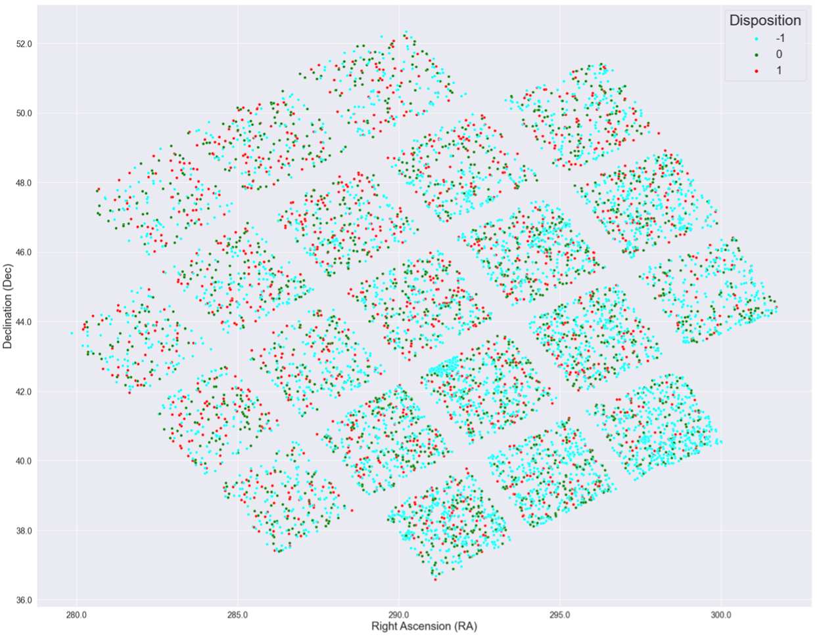
Methodology EDA: Bivariate Analysis
Fig. 3 is a star map with RA and Dec coordinates
Fig 3. Star Map by Right Ascension (RA) and Declination (Dec)

Slide 13
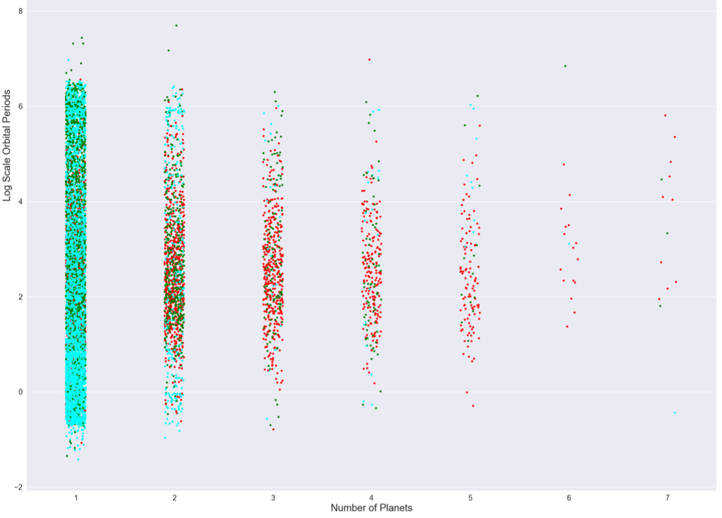
Methodology EDA: Bivariate Analysis
Fig. 4 shows that false positive samples are most likely to have just one or two planets in their solar system
Fig 4. Categorical Plot of the Log Scale Orbital Period versus Number of Planets

Slide 14
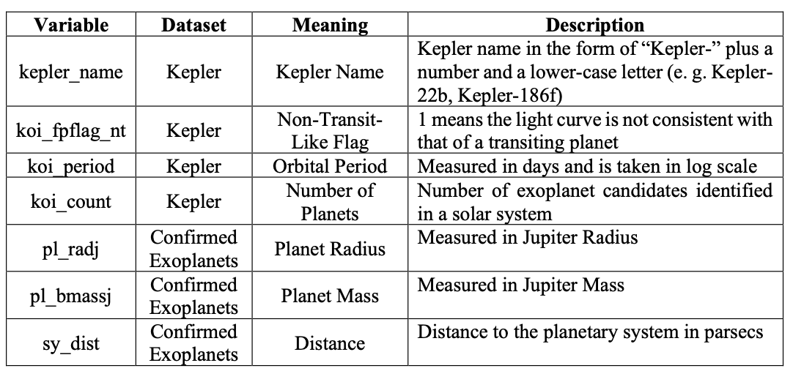
Methodology Feature Selection
Preserve variables with high feature-target correlation and low feature-feature correlation
Table 1. Examples of Preserved Features after Feature Selection

Slide 15
Methodology Classification Tree
Decision tree splits data with classification rules based on the highest information gain
In a classification tree model, each internal node represents a sample to be split, and each leaf node represents a class label, or prediction
We set the minimum number of samples required to split an internal node from 2 to 100 and maximum depth of the tree from 1 to 20, then we selected the parameters with the highest accuracy
The optimal minimum number of samples required to split an internal node is 53 and maximum depth of the tree is 7

Slide 16
Methodology Random Forest
Random forest combines multiple decision trees at the training time
We optimized the number of trees in the forest by setting this parameter from 20 to 1000 with a step size of 20
As a result, the highest accuracy was obtained when the number of trees is 40

Slide 17
Methodology Naïve Bayes
Naïve Bayes applies Bayes’ theorem under the assumption that features are independent
It’s a simple probabilistic approach to conduct the classification task
Before training the naïve Bayes classifier, we standardized input features, encoded the target variable as a one-hot vector, and set each prior as the proportion of each class in the sample space

Slide 18
Methodology Neural Network
Neural network is another machine learning model that is widely used in classification problems
We tried three activation functions, logistic, tanh, and ReLU
We also chose three types of solvers, stochastic gradient descent, quasi-Newton method, and Adam optimizer
Finally, we optimized the layer size and learning rate
The optimal neural network uses tanh as the activation function and Adam as the optimizer with a layer size of 25 and a learning rate of 0.003

Slide 19
Methodology K-means
K-means is a classic unsupervised learning algorithm for clustering problems
It partitions data into k clusters with the objective of minimizing the sum of distance of each sample to its cluster centroid in a repeated way
We aimed at finding out which exoplanets are in the same group as the earth that might indicate potentially habitable places for human beings

Slide 20
Outline
Introduction
Related Work
Methodology
Experimental Results & Analysis
Future Work

Slide 21
Experimental Results & Analysis Accuracy & Cross Validation
Classification tree: 99.06%
Random forest: 92.11%
Naïve Bayes: 88.50%
Neural Network: 99.79%
We further evaluated the performance of these models with 10-fold cross-validation and the random forest model achieved the best average accuracy of 82.39%

Slide 22
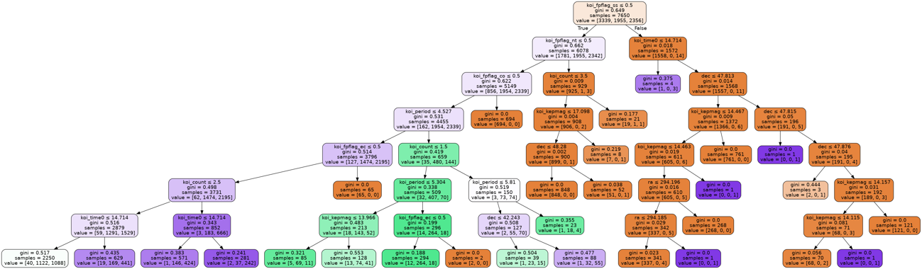
Experimental Results & Analysis Optimal Tree
We visualized the classification tree with the highest accuracy
In addition, we plotted the importance of each feature
Fig 5. The Optimal Decision Tree

Slide 23
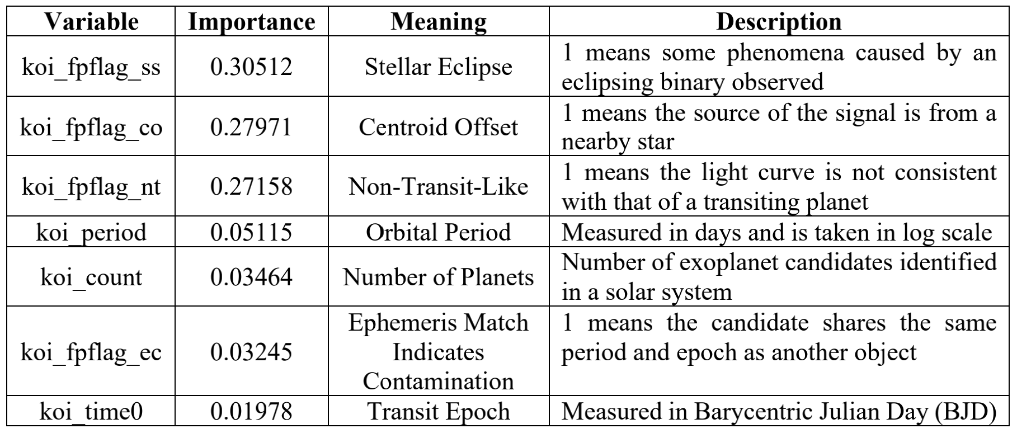
Experimental Results & Analysis Feature Importance
Get the importance of each feature
Table 2. Kepler Feature List with Variable Name, Importance, Meaning, and Description

Slide 24
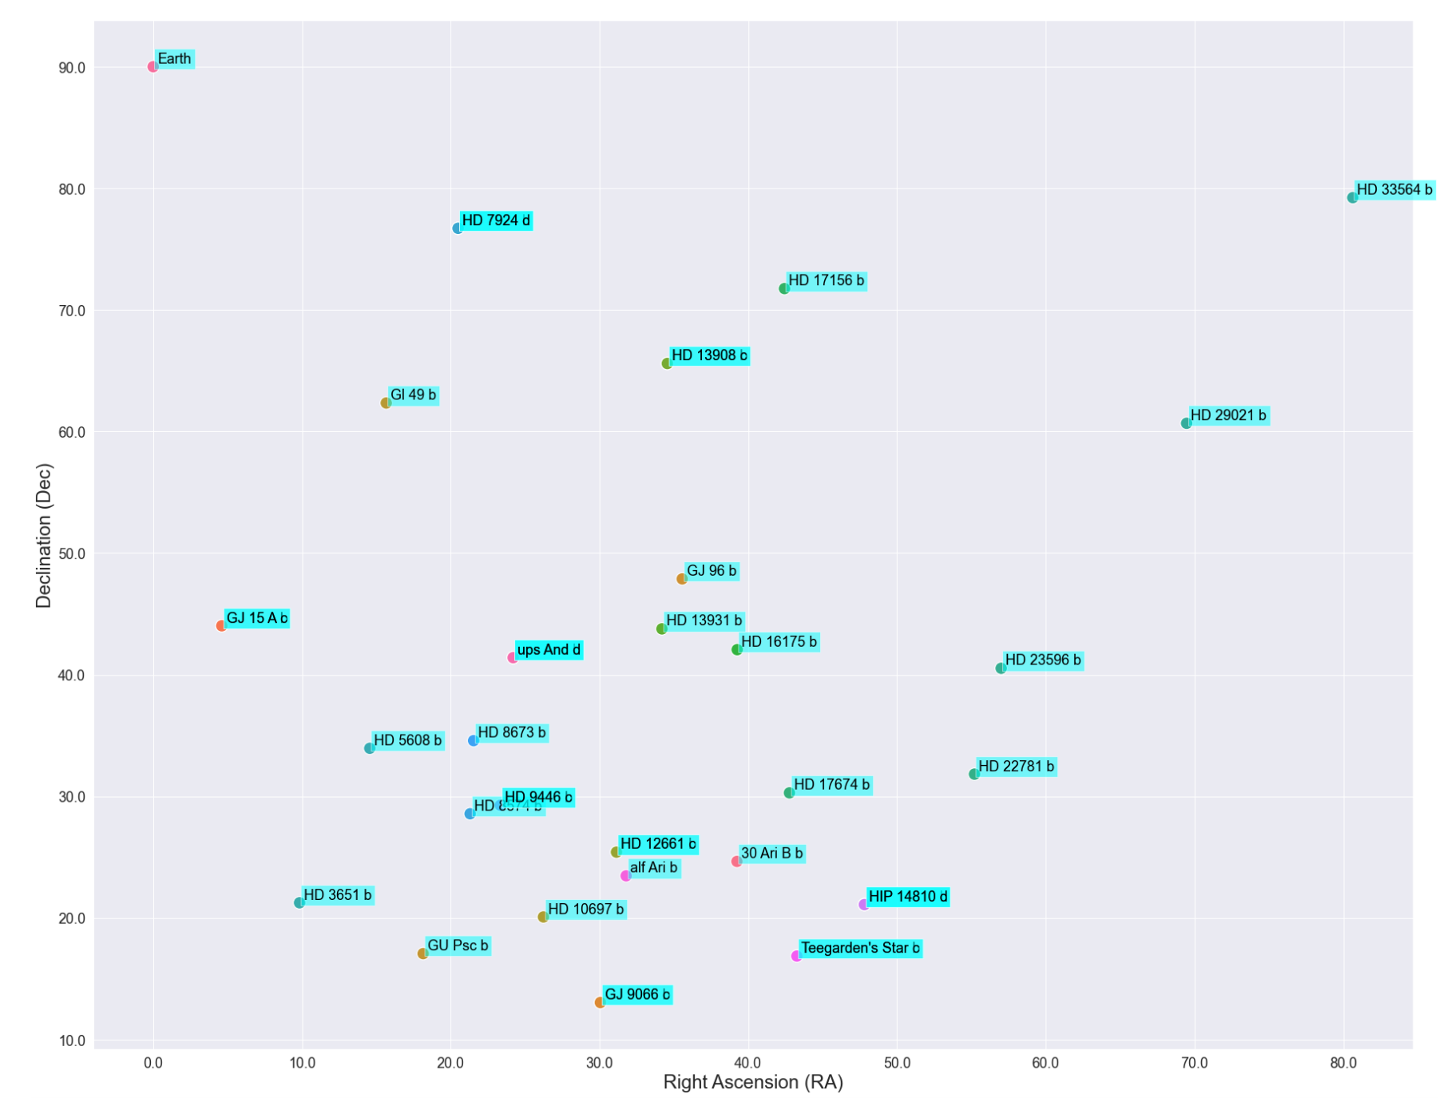
Experimental Results & Analysis Habitable Exoplanet Candidates
Fig 6. Star Map of the Exoplanets in the Same Cluster as the Earth

Slide 25
Outline
Introduction
Related Work
Methodology
Experimental Results & Analysis
Future Work

Slide 26
Future Work
It might be interesting to create new features from the current feature set using feature engineering techniques, because they can be helpful to improve the model performance
In addition, we can investigate the receiver operating characteristics (ROC) and the precision-recall curves to understand the diagnostic ability of different machine learning models
McNamara’s test can also be applied to compare different algorithms
Finally, the discussion of statistical significance tests and execution time can be included in model evaluation

